Slide 1
Challenges in our Community
Barbara Wilcox
Generalist Adviser

Slide 2
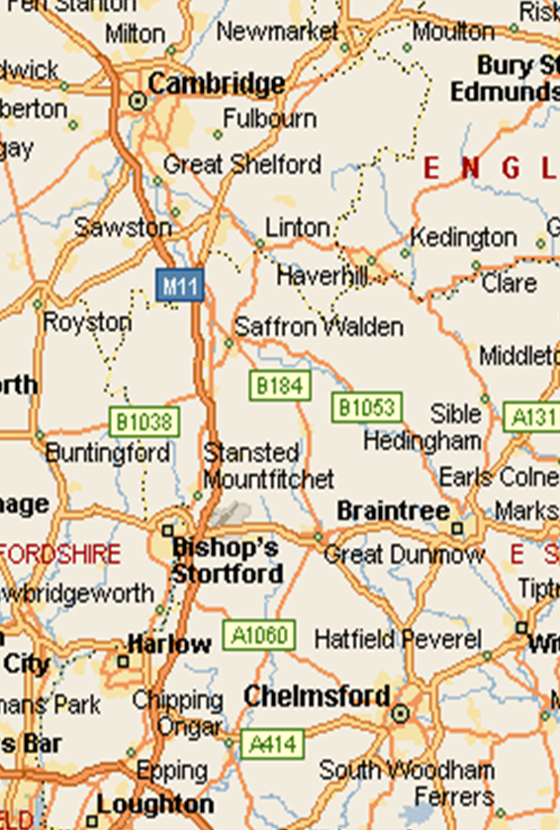
Uttlesford
One of the least deprived areas in the country
But 8% of our children live in poverty, up to a quarter in some areas
Rural and “on the edge”: of the County, Health Authority, Cambridge Sub-region
Distant facilities: Job Centre in Braintree; night shelter, courts in Cambridge
Assumption that all have car and money
Notes:
2

Slide 3
Health Challenges
5% of people have a disability or long term condition which limits them a lot
Increasing older population, and more people with dementia
Excess winter deaths are double the national average
1 in 12 households are fuel-poor
Interaction of factors – health, income,
fuel costs and housing

Slide 4
House prices
House price earnings ratio
for lowest quartile
In Essex only Epping Forest
has higher ratio
Lower quartile price is £320,000

Slide 5
Rented housing
Private rented sector growing
Limited security of tenure
Moving fees and costs
Benefits levels below actual rents
Better off in south of Uttlesford
Saffron Walden April 2019

Slide 6
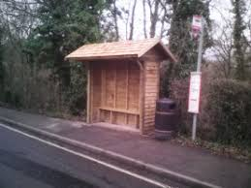
Transport
10% households have no car
Car running costs £20 per week, not affordable if on benefits
Virtually no bus services for many places, information hard to find
Expensive: £47 per week for 2 children Widdington to Walden
7 hour round trip to Job Centre

